Slide 1
AES Solved example

Slide 2
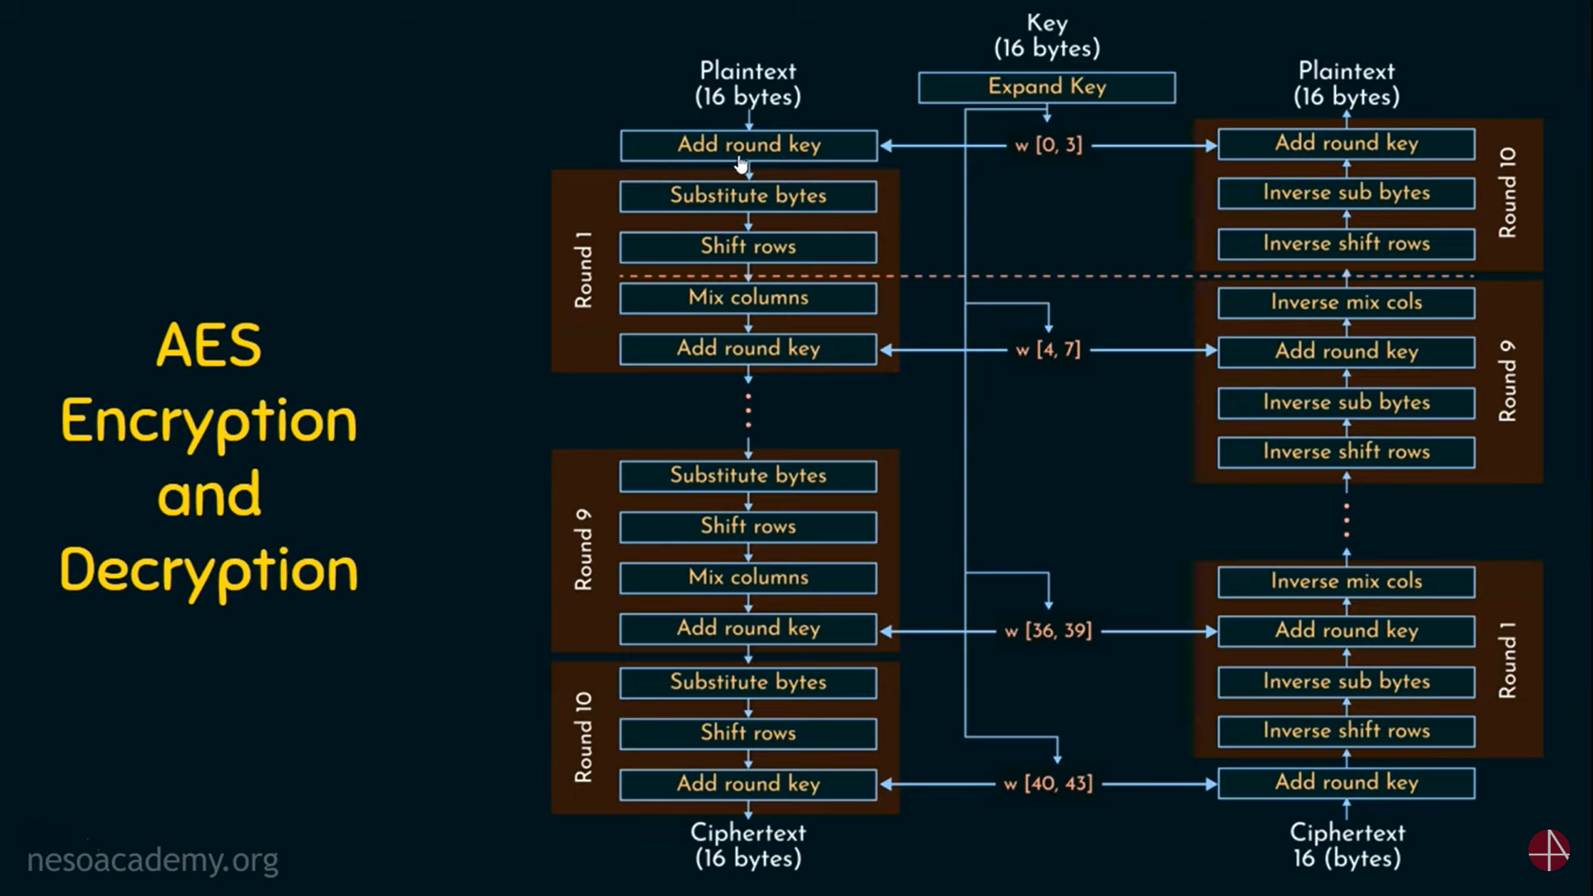
16 ASCII character (1 byte each) key in hex
T | H | A | T | S |  | M | Y |  | K | U | N | G |  | F | U
54 | 68 | 61 | 74 | 73 | 20 | 6D | 79 | 20 | 4B | 75 | 6E | 67 | 20 | 46 | 75
W0 | W1 | W2 | W3
54 | 73 | 20 | 67
68 | 20 | 4B | 20
61 | 6D | 75 | 46
74 | 79 | 6E | 75
We will check that how (w4,w7) will be generated from (w0, w3)
This column for k1 round 1 in AES algorithm

Slide 3
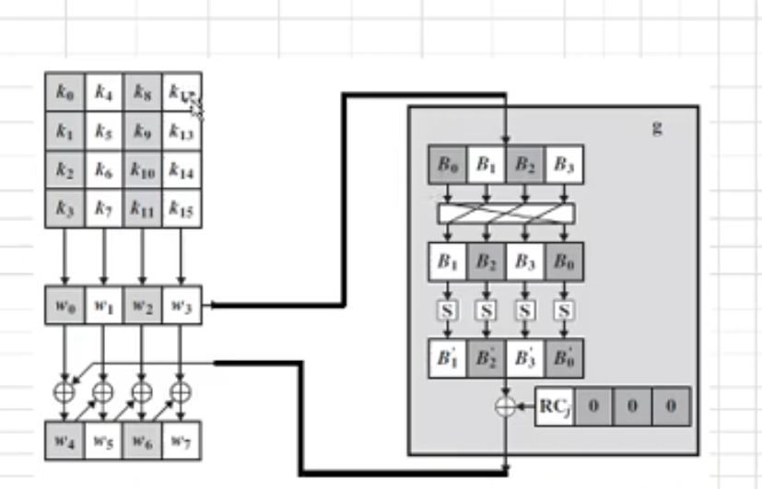
GF function for key substitution
We will apply G function on w3
1st we will apply left shift function on W3 so it will be
67 20 46 75
20 46 75 67 After apply left shit
Now will apply s-box substitution
After s-box substitution this key will be
B7 5A 9D 85
Now XOR with R constant which is
01 00 00 00 after XOR key will be
G(w3) = B6 5A 9D 85
W3 XOR with w0 then w4 will be generated and so on
Key generation for 1 round

Slide 4
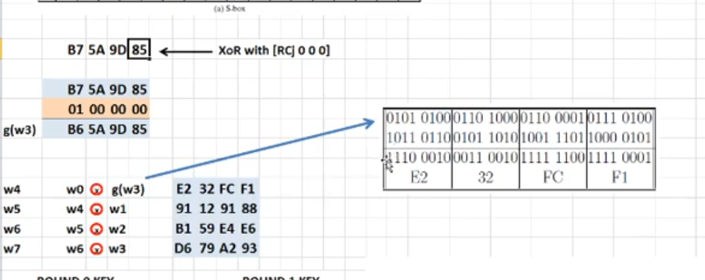
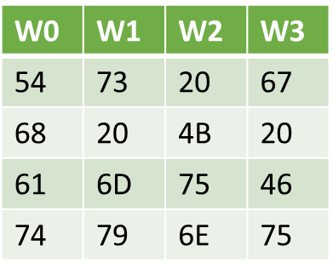
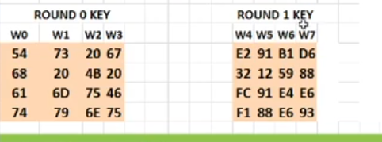
Generating (w4,w7)
Next all rounds key is generated by using this same method
w4= 54 68 61 74 xor B6 5A 9D 85
W5 = E2 32 FC F1 xor 73 20 6d 79
W6 = 91 12 91 66 xor 20 4b 75 6E
W7 = B1 59 E4 E6 XOR 67 20 46 75

Slide 5
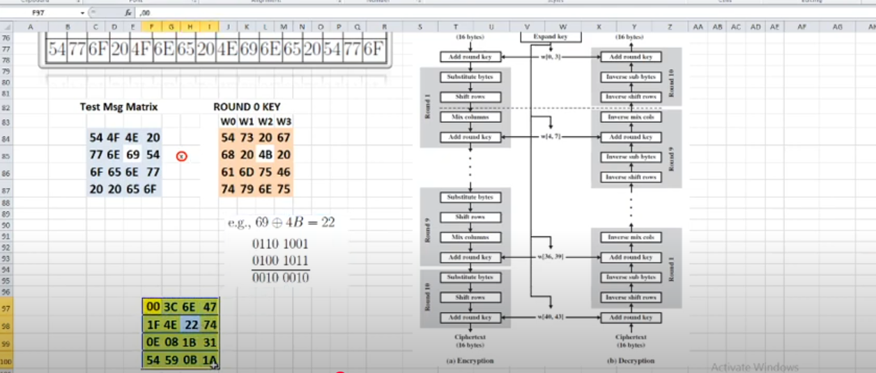
Round 1

Slide 6
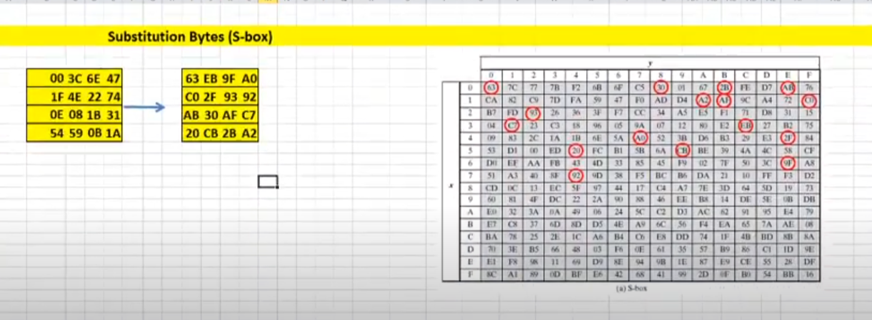
S-box substitution

Slide 7
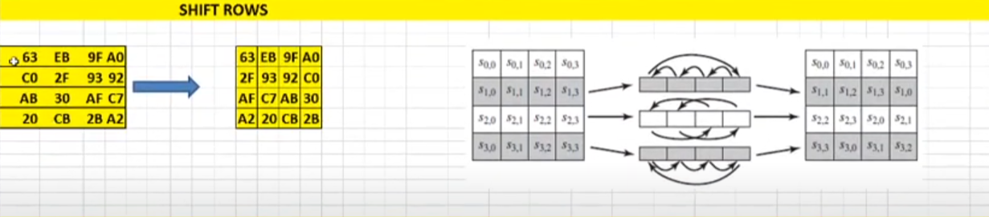
Shift Rows

Slide 8
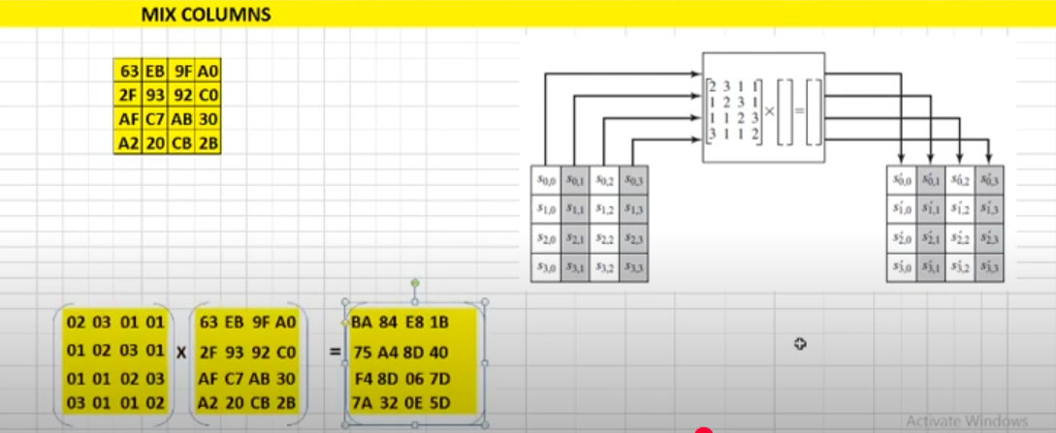
Mix columns

Slide 9
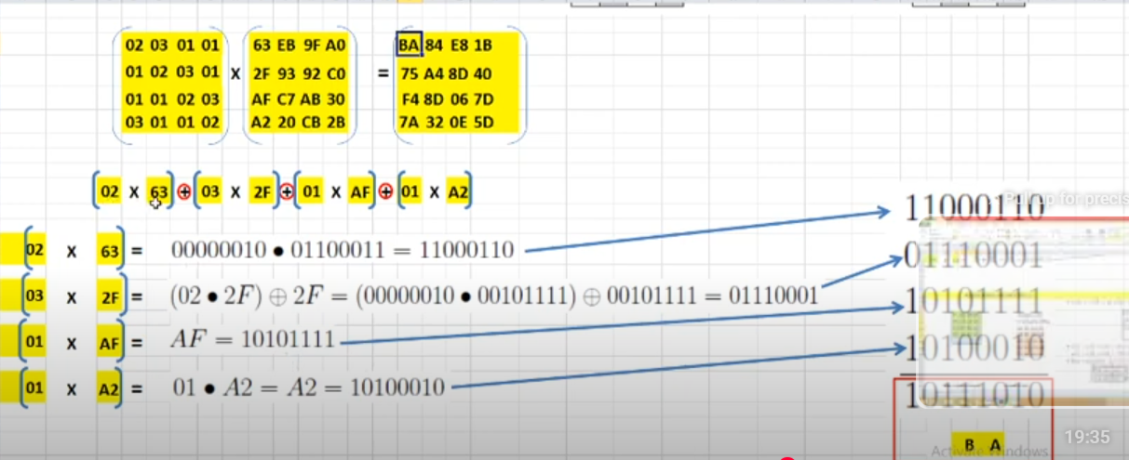
Mix column calculations

